Slide 2
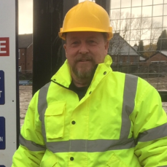
NVQ Level 3 Electrical Installations Assessor - Paul Charles Rick Douglas Phone Paul - 07595 385 513 Rick - 07597 391 710 Email - pcharles@eruditetraining.net rdouglas@eruditetraining.net

Slide 3
What you will need. A phone to take photos. A computer to upload photos too and to download the templates. A printer to print off completed templates to put into the portfolio. If you do not have access to these then you cannot complete the NVQ.

Slide 4
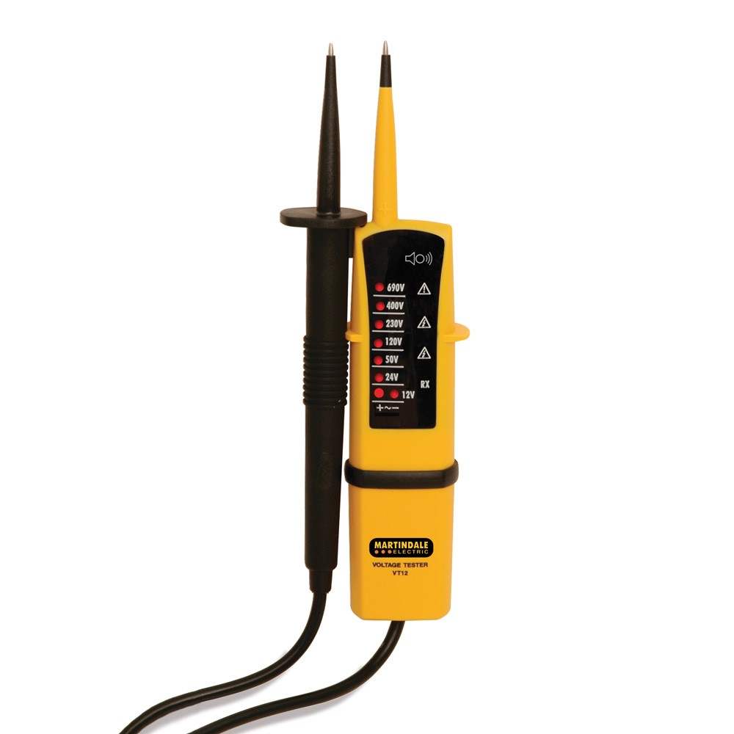
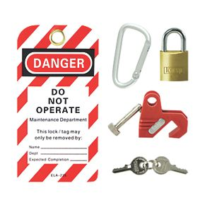
You will need a dedicated voltage indicator
Please NO volt sticks or Neon Screwdrivers
You will also need a lockout kit

Slide 5
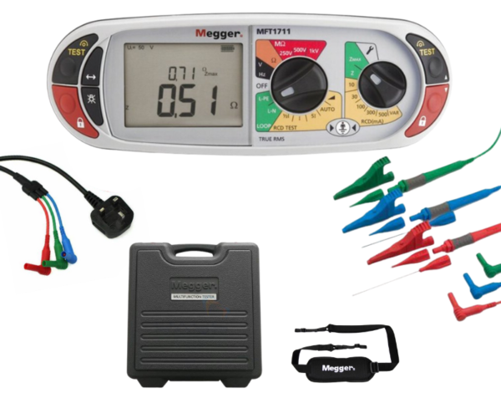
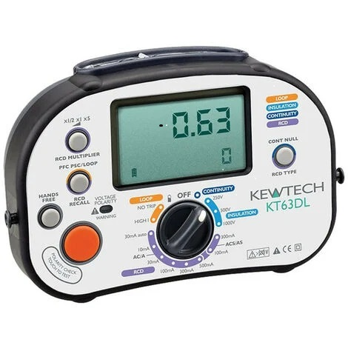
You will need a meter for testing and fault finding.

Slide 6
You will also need a barrier or barrier tape
and a safety sign.

Slide 7
You will need to download
‘WhatsApp’
and
‘What3words’

Slide 8
Download a programme ‘PIXresizer’
https://pixresizer.en.softonic.com
With this you can set the photos size to around 225
Make a file (a) and upload all photos from you phone into the file
Make a second file (b)
Open PIXresizer click on source and enter file (a)
Click on destination and enter file (b)
Set the size to around 225
Click on ‘save pictures’
All photos will now be copied over to a more user friendly size into file (b)

Slide 9
Decide which route you are taking. 501 EAL Level 3 NVQ Diploma in Installing Electrotechnical Systems and Equipment (buildings, structures and the environment) (AM2) 603 EAL Level3 Electrotechnical Experienced Worker Qualification (AM2E) Must be over 21 years old for this route.

Slide 10
.

Slide 11
501 EAL Level 3 NVQ Diploma in Installing Electrotechnical Systems and Equipment (buildings, structures and the environment) (AM2) You must have completed your Level 2 and Level 3 technical certificate (diploma) You may need to complete a bridging unit. Depending which qualifications you have completed will determine which bridging unit(s) need to be taken.

Slide 12
603 Level3 Electrotechnical Experienced Worker Qualification (AM2E) You must be at Level 3 standard and have been working as an electrician for at least 5 years (and be at least 21 years old). You must also complete:- (1) BS7671 (18th Edition) and (2) Initial Inspection and Testing (Level 3) If you do not have a Level 3 then complete BS7671 (18th Edition) and Initial Inspection and Testing first as these are both Level 3.

Slide 13
To complete the NVQ you must provide evidence to prove competence. This evidence shall be provided by naturally occurring work and must not be simulated. No training shall be provided to aid this evidence.

Slide 14
Evidence to be provided by:- (1) Direct Observation by assessor – incl. all of unit 01 1st fix 2nd fix Isolation procedures Testing (2) Product Evidence – templates (could use video, try to do 1 of these) (3) Witness Testimony (try to do 2 of these) (4) Professional Discussion – mopping up exercise.

Slide 15
Producing a video Make sure you introduce yourself at the start of the video, showing yourself on the video so we can be sure this is you providing the evidence.

Slide 16
Templates www.nvqhelp.co.uk You may need more than one photo. (you should be on the photo were possible) i.e. isolation procedures x7 photos for single phase x14 photos for three phase

Slide 17
When emailing a unit with photos, you
may find it too large for the email to send as a Word document. Print a 2nd copy as a pdf.
OR
You can send by
www.wetransfer.com
which is free to use.

Slide 18
How to set out your portfolio of evidence

Slide 19
All evidence to be collected on 2 separate occasions (different dates) (job 1 + job 2)

Slide 20
501 603 Job 1 Unit 02 Job 1 Unit 03 Job 1 Unit 03 Job 1 Unit 04 Job 1 Unit 04 Job 1 Unit 05 Job 1 Unit 05 Job 1 Unit 06 Job 1 Unit 06 Job 1 Unit 07 Job 1 Unit 07 Job 2 Unit 02 Job 2 Unit 03 Job 2 Unit 03 Job 2 Unit 04 Job 2 Unit 04 Job 2 Unit 05 Job 2 Unit 05 Job 2 Unit 06 Job 2 Unit 06 Job 2 Unit 07 Job 2 Unit 07 Miscellaneous Miscellaneous Witness testimonies Witness testimonies Professional discussion Professional discussion Observations 1 Observations 1 Observations 2 Observations 2 Observations 3 Observations 3

Slide 21
Use photos more than once where you can. (but only on one form of evidence) i.e. RAMS can be used in 6 different places on 603 and 8 different places on 501 .

Slide 22
All evidence should be authentic. (not stood with screwdriver in hand on a finished product) When installing containment show:- (1) start (2) middle (3) end

Slide 23
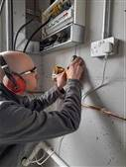
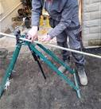
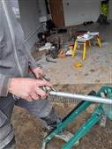
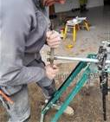
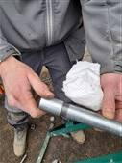
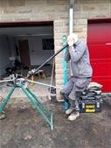
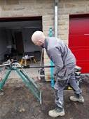
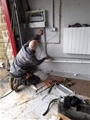
Installing steel conduit

Slide 24
When terminating cable show:- (1) start (the cut end of cable) (2) middle (then stripping cable) (3) end (then terminating conductors) * SWA and MICC will need more photos

Slide 25
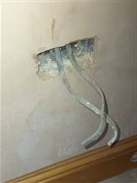
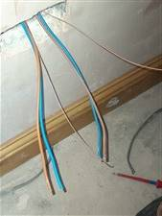
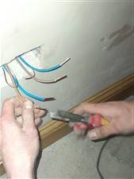
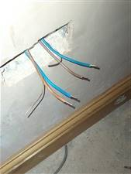
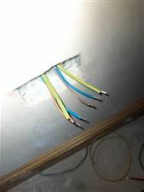
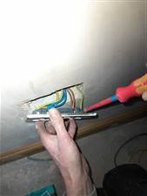
Terminating PVC/PVC twin and earth

Slide 26
The evidence must be collected after the date you were registered on the course.

Slide 27
Once you have completed a unit, email this for assessment straight away. Your feedback for this unit will help guide you on the right path for the other units. Then email each unit as soon as it is completed.

Slide 28
The evidence you produce cannot be submitted in its entirety at the end. This is known as ‘End Loading’ and is not acceptable to the awarding bodies. When you have collected around 50% of the evidence then you need to hand in your portfolio for assessment and IQA. Then when you have collected the remaining evidence it can be handed in again for assessment and IQA.

Slide 29
Site Visits On each visit you will need full PPE:- Hard hat Hi-Vis Protective footwear Gloves Eye protection Ear defenders Dust mask You will also need to produce for each visit a:- (1) Risk Assessment (2) Method Statement.

Slide 30
It is the candidates responsibility for arranging an on-site visit with their assessor at a mutually agreed place, time, and date.

Slide 31
You will need to contact your assessor (by WhatsApp or email) with a progress report on the first Monday of each month

Slide 32
How long will it take me to complete the NVQ or Experienced Worker route? It should take anything between 6 months to 2 years.

Slide 33
The AM2 is part of the 501 The AM2E is not part of the 603 The AM2E cannot be taken until the 603 has been completed and must be done at a licensed NET centre.

